Slide 1

Employee Management System
Technology: Core Java
Mid-Term Project Presentation
Course: Software Development Project II
Dept. of CSE -PUB
28 February 2026
Presented By:
Md. Ashiqur Rahman (Roll: 09)
Pollob Kumar (Roll: 23)
Md. Tanzid Mondol (Roll: 48)

Slide 2

Introduction
An Employee Management System (EMS) is a software application used to manage employee-related information efficiently.
It helps organizations to:
Store employee records
Update employee details
Manage department information
Improve administrative efficiency
This project is developed using Core Java.
02

Slide 3

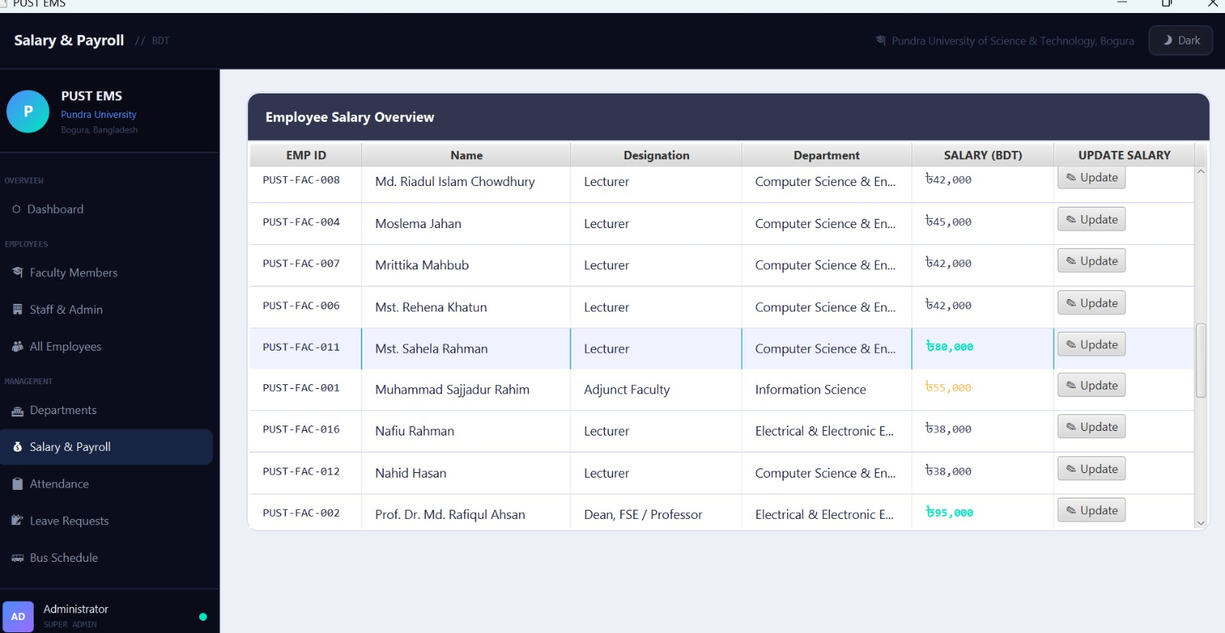
Problem Statement
Traditional employee management methods:
Manual record keeping
Paper-based documentation
Risk of data loss
Time-consuming updates
Our project aims to:
Digitize employee information
Provide a user-friendly interface
Make employee data management simple and organized
03

Slide 4
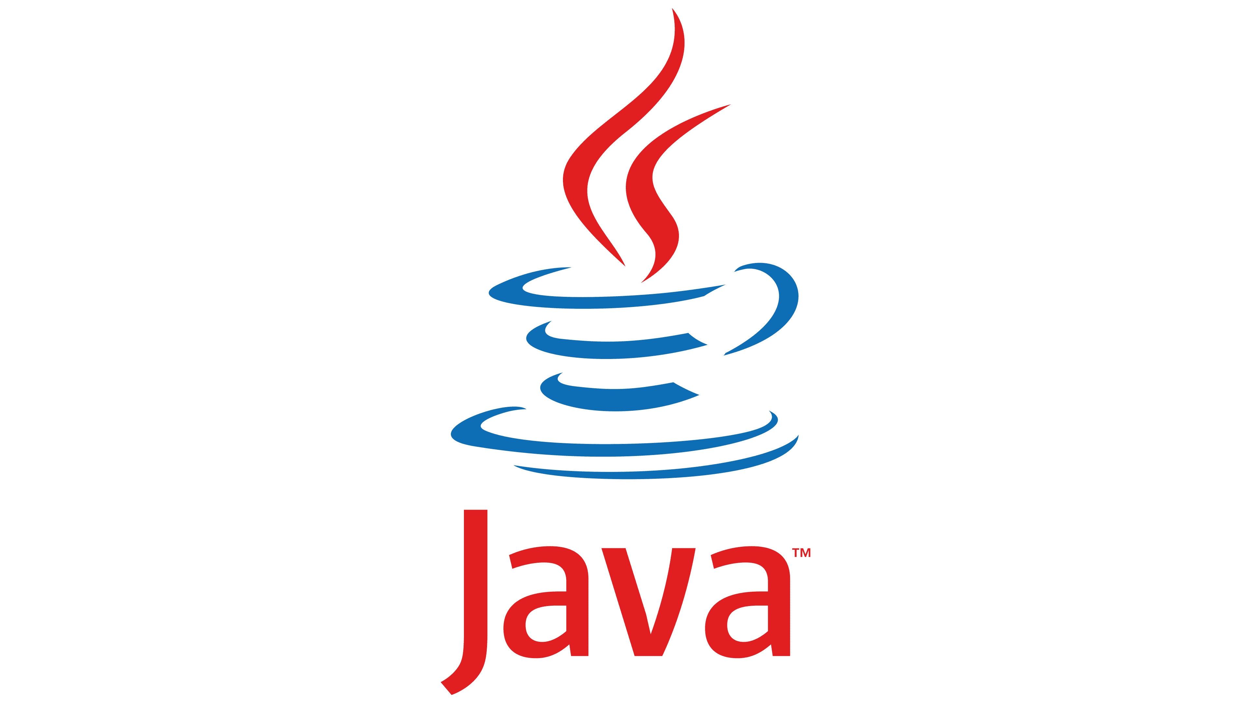

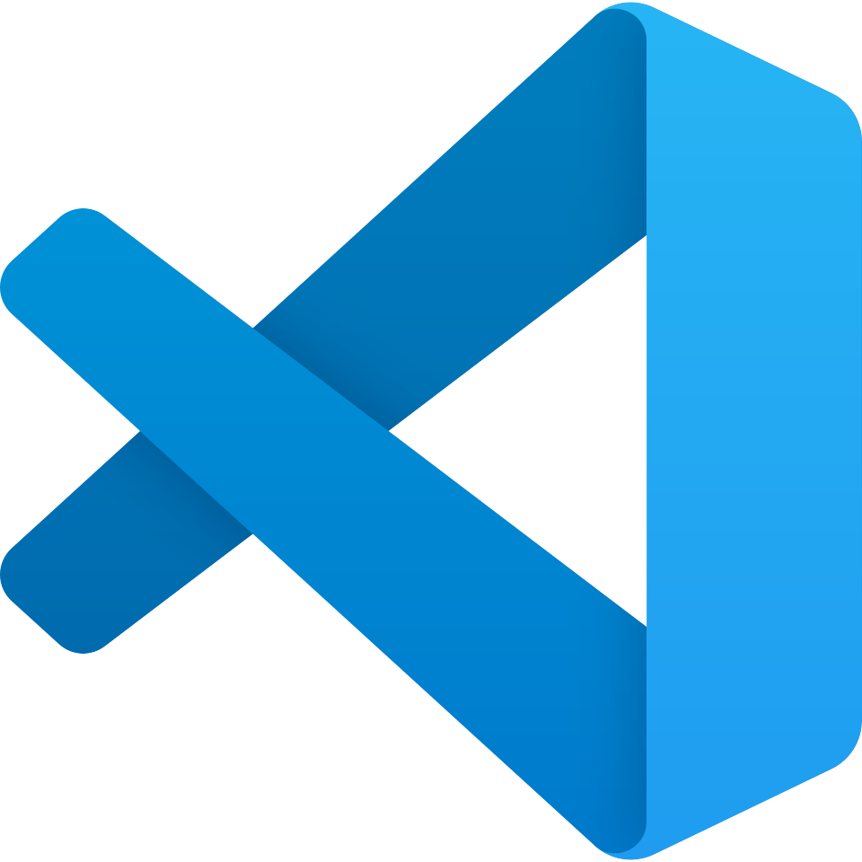
Technologies Used
Programming Language:
Core Java
Frontend Technologies:
Java Swing
Java FX
Planned Database:
MySQL
Development Environment:
Visual Studio Code
04

Slide 5
Comparison Table
Project Name | Technology | Features | Limitations | Our Contribution
Orange HRM | Web (PHP/MySQL) | Comprehensive HR suite, cloud-based | Requires internet, complex setup, licensing costs | Desktop app, offline, lightweight, free
BambooHR | Web (Cloud) | Employee records, time tracking | Subscription-based, internet dependent | One-time setup, no recurring costs
Simple Employee DB | Java/Access | Basic CRUD operations | No attendance, payroll, leave management | Complete HR solution with all modules
HR Management CLI | Java Console | Employee management via CLI | No GUI, difficult for non-technical users | Modern Swing GUI, user-friendly
Our Project: Employee Management System | Java Swing + MySQL | Complete HR solution: Employee, Attendance, Leave, Payroll, Reports, Dashboard | Limited to single organization, desktop-only | Modular OOP architecture, comprehensive features, offline-capable, role-based access, PDF reports
05

Slide 6
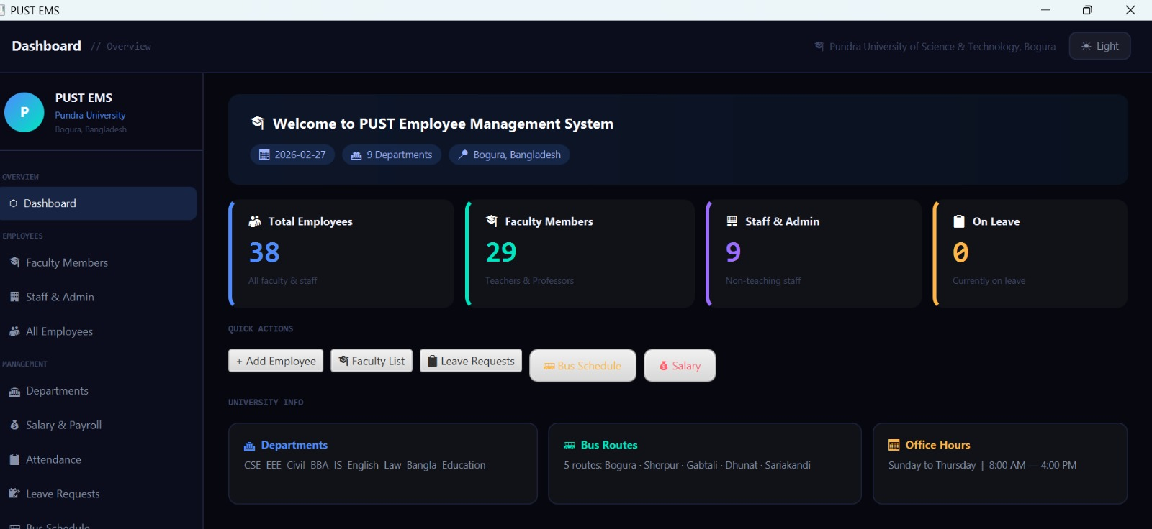
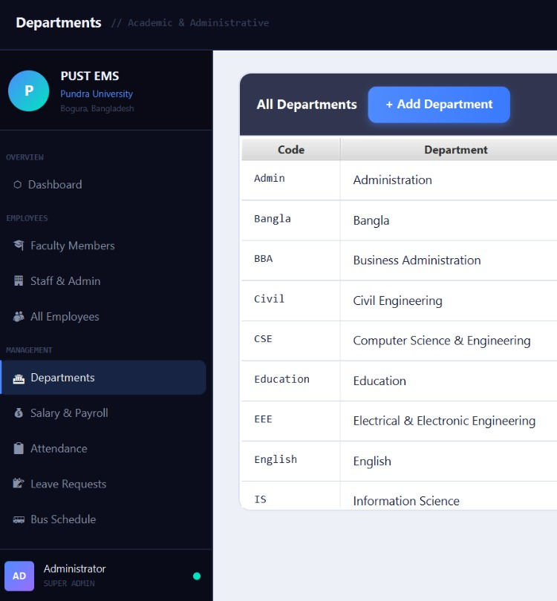
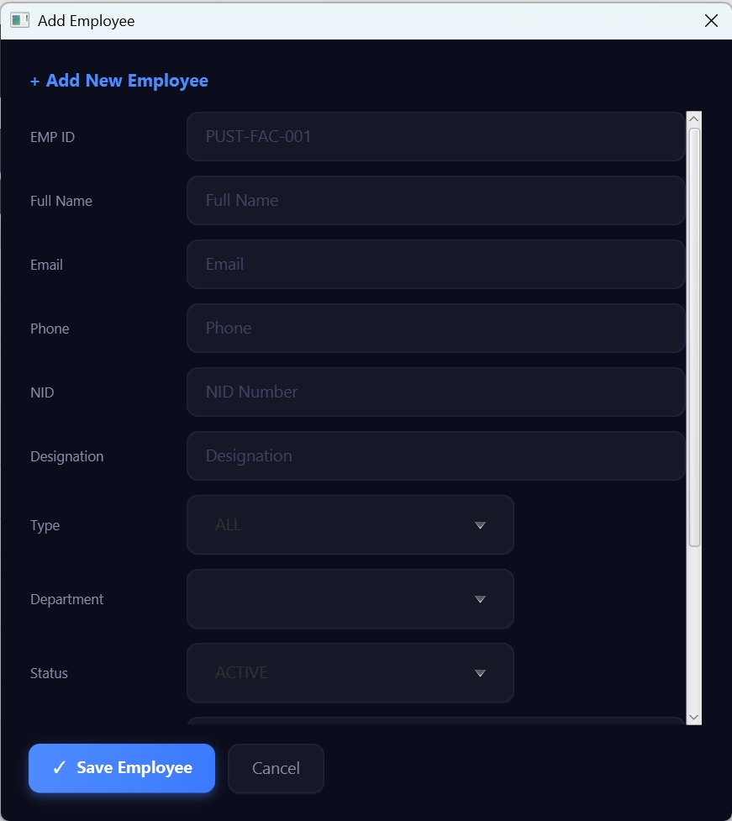
Key Features
Implemented Features:
Add new employee
Update employee information
Delete employee
View employee details
Simple navigation system
The system is fully functional at the interface level.
06

Slide 7
System Architecture
3-Tier MVC Architecture | Technology Stack
Tier 1 Presentation Layer
TECH STACK
Login Window
Main Window
Modular Screens
Dark/Light Theme
JavaFX 21.0 UI
Java JDK 17+
JavaFX 21.0.10
Tier 2 Business Logic Layer
EmployeeDAO
DepartmentDAO
LeaveDAO / BusDAO
DAOFactory
MySQL 8.0
Java DAO Pattern
JDBC Connector/J 9.6
CSS Styling
Tier 3 Data Access Layer
pust_ems Database
7 Tables
MySQL Connector/J
Connection Pooling
MySQL + JDBC
Windows 10/11
IntelliJ / VS Code
07

Slide 8
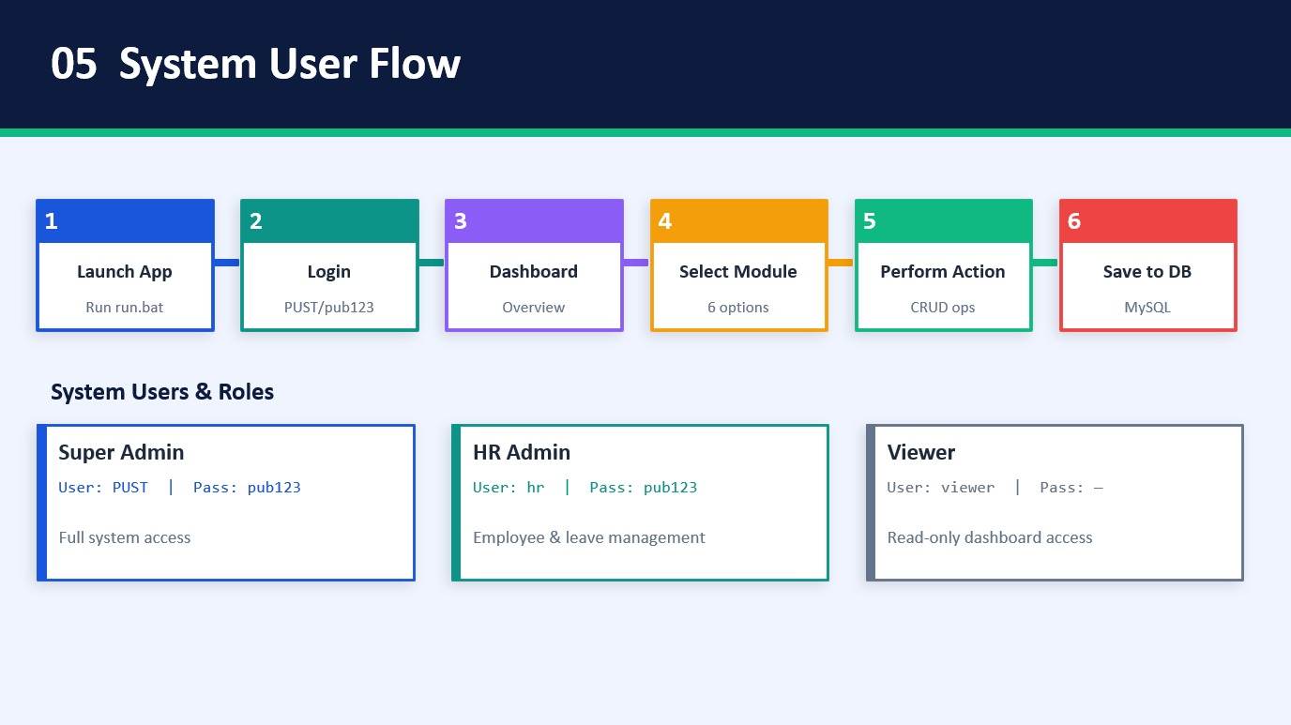
08

Slide 9
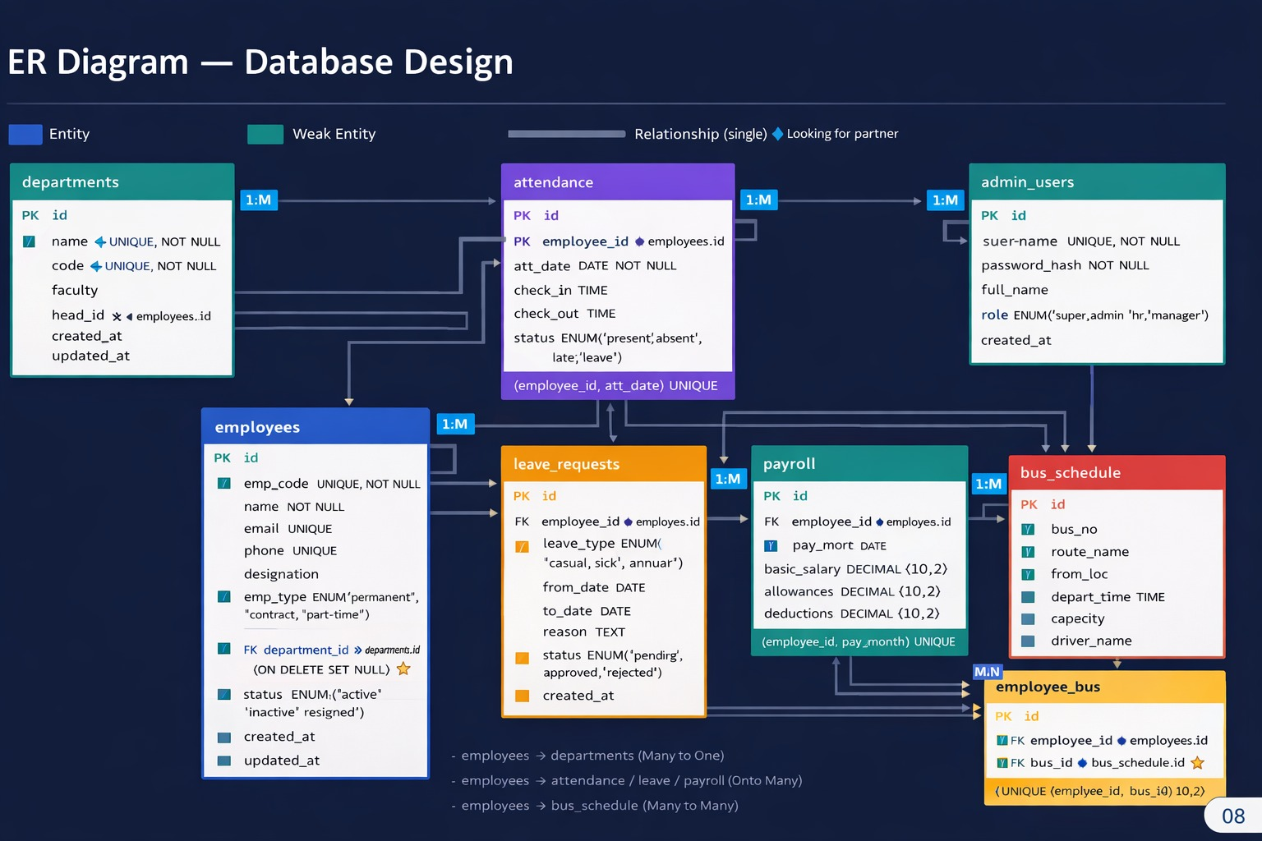
09

Slide 10
Project timeline Gantt Chart
Jan 10
Jan 17
Jan 24
Feb 3
Feb 14
Requirement Analysis
Project Planning
Planning
System Design
Admin Login
Registration
Development
Add Employee
10

Slide 11
Conclusion &
Future Scope
What We Built
Future Scope
Complete Employee Management System for PUST
📧 Email notification system
28 Faculty + 9 Staff + Admin users loaded
📊 Analytics & reporting dashboard
6 functional modules with full CRUD
📱 Mobile app version
Dark & Light theme with JavaFX
☁ Cloud / online deployment
MySQL backend with 7 normalized tables
🔐 Biometric attendance integration
Login system with role-based access
📄 PDF payslip generation
11

Slide 12
References
[1] Oracle Corporation, "Java Swing Tutorial," Oracle Java Documentation, 2024. [Online]. Available: https://docs.oracle.com/javase/tutorial/uiswing/ [Accessed: January 16, 2026].
[2] MySQL Documentation, "MySQL 8.0 Reference Manual," MySQL, 2024. [Online].
Available: https://dev.mysql.com/doc/ [Accessed: January 31, 2026].
[3] GeeksforGeeks, "Java Database Connectivity (JDBC)," 2024. [Online]. Available: https://www.geeksforgeeks.org/jdbc-drivers/ [Accessed: 14 February, 2026].
PUB EMS | Pundra University of Science & Technology, Bogura | JavaFX + MySQL
12

Slide 13


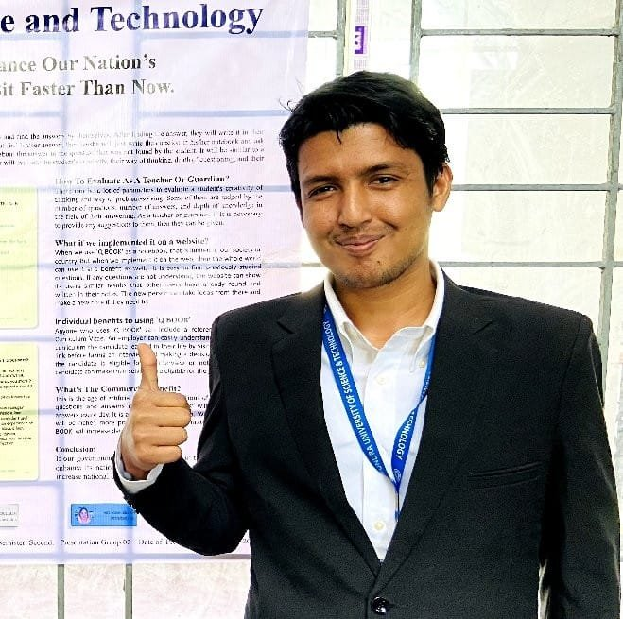
Thank You

